Slide 1
Mirror Matches
24 Annotations + 71 Analogs

Slide 2
Annotations

Slide 3
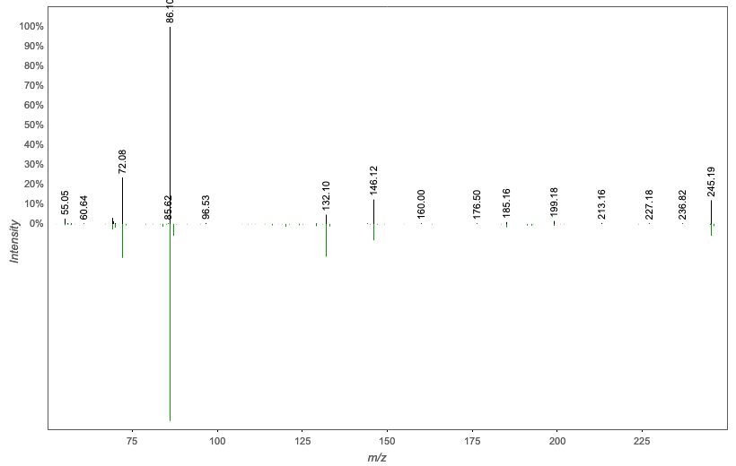
Annotation | M/Z | RT | Cosine Score | Shared Peaks | Cluster Index
Spectral Match to Leu-Ile from NIST14 | 245.186 | 2.22 | 0.9372 | 7 | 914

Slide 4
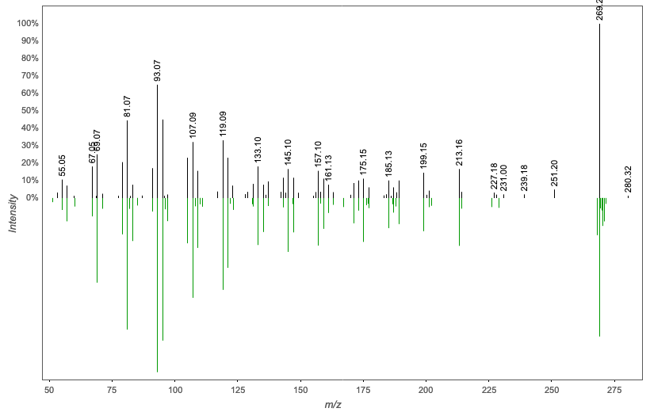
Annotation | M/Z | RT | Cosine Score | Shared Peaks | Cluster Index
Spectral Match to Retinol from NIST14 | 269.225 | 3.2 | 0.9321 | 12 | 2691

Slide 5
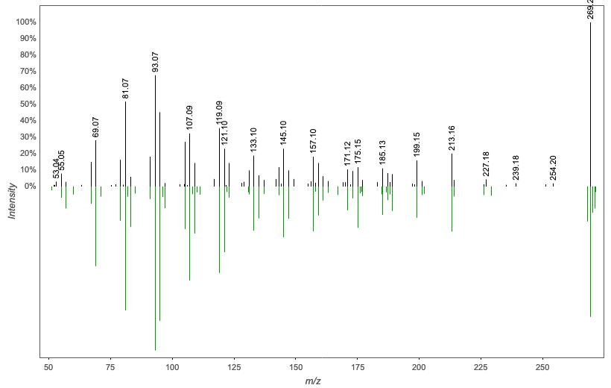
Annotation | M/Z | RT | Cosine Score | Shared Peaks | Cluster Index
Spectral Match to Retinol from NIST14 | 269.225 | 4.91 | 0.9142 | 10 | 2702

Slide 6
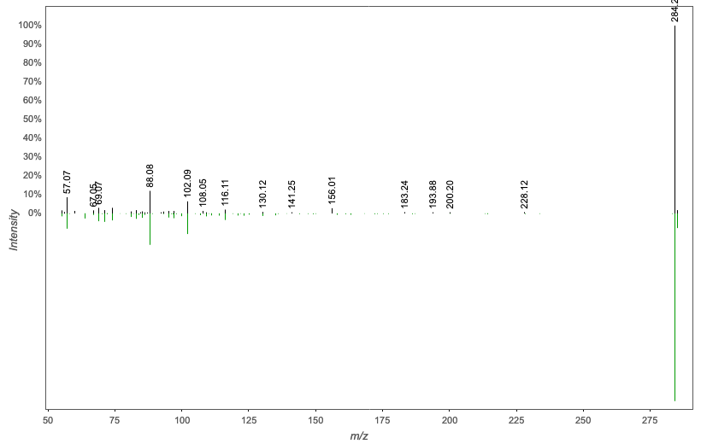
Annotation | M/Z | RT | Cosine Score | Shared Peaks | Cluster Index
Spectral Match to Octadecanamide from NIST14 | 284.293 | 3.31 | 0.8446 | 6 | 1336

Slide 7
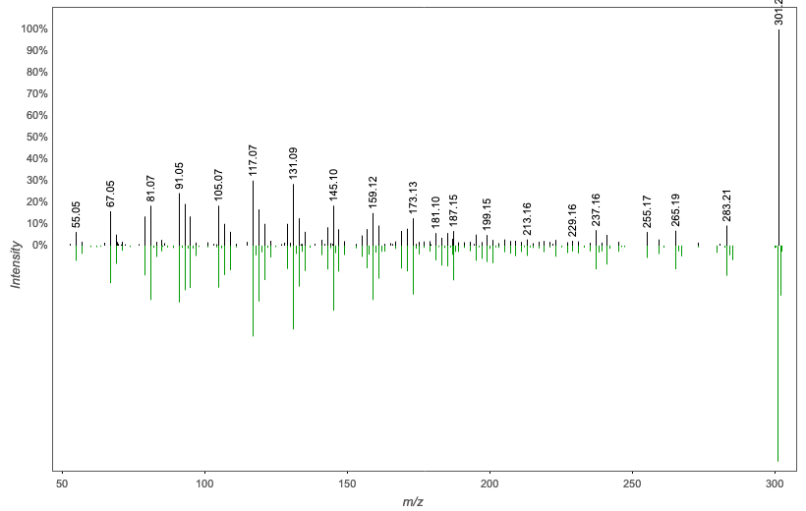
Annotation | M/Z | RT | Cosine Score | Shared Peaks | Cluster Index
Spectral Match to (.+/-.)-5-Hydroxy-6E,8Z,11Z,14Z,17Z-eicosapentaenoic acid from NIST14 | 301.215 | 2.91 | 0.8868 | 14 | 1980

Slide 8
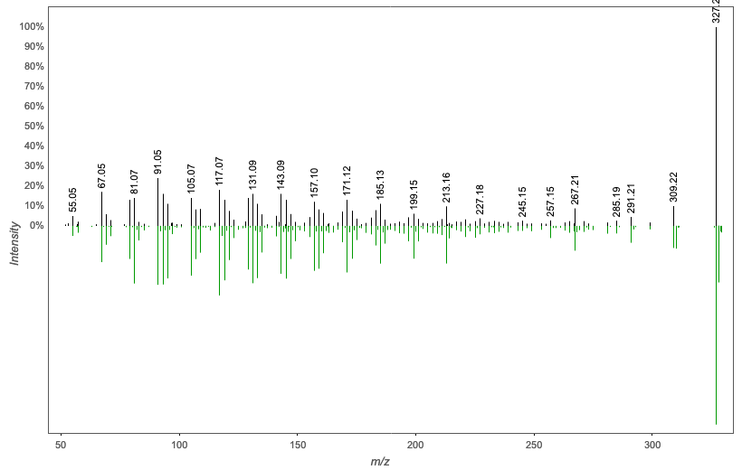
Annotation | M/Z | RT | Cosine Score | Shared Peaks | Cluster Index
Spectral Match to (.+/-.)-11-Hydroxy-4Z,7Z,9E,13Z,16Z,19Z-docosahexaenoic acid from NIST14 | 327.23 | 2.97 | 0.7606 | 13 | 1862

Slide 9
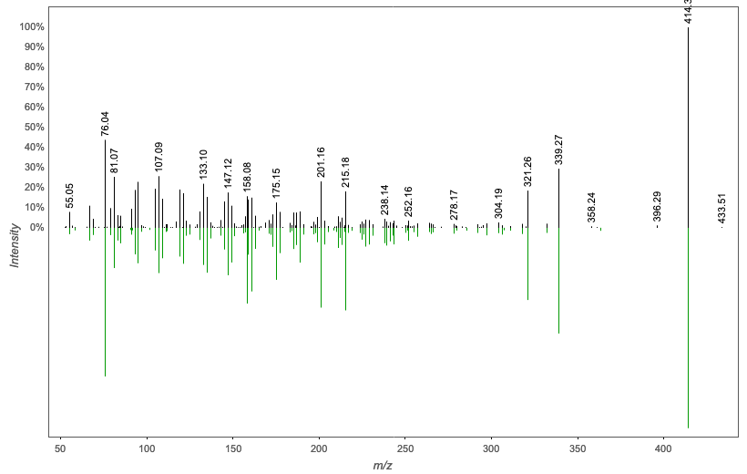
Annotation | M/Z | RT | Cosine Score | Shared Peaks | Cluster Index
glycoursodeoxycholic acid | 414.298 | 2.69 | 0.7376 | 11 | 2351

Slide 10
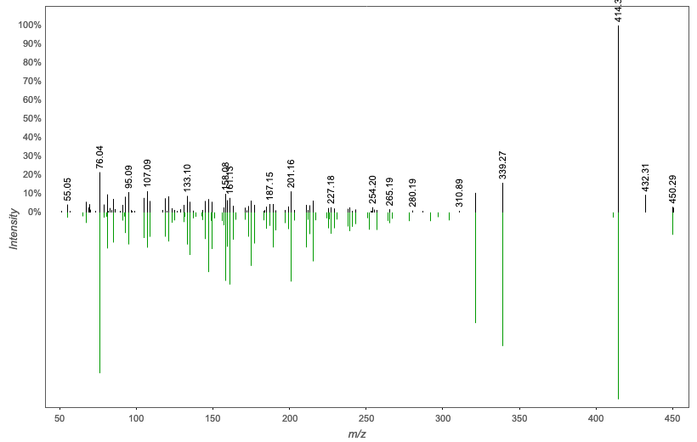
Annotation | M/Z | RT | Cosine Score | Shared Peaks | Cluster Index
glycoursodeoxycholic acid | 450.32 | 2.69 | 0.8122 | 14 | 2209

Slide 11
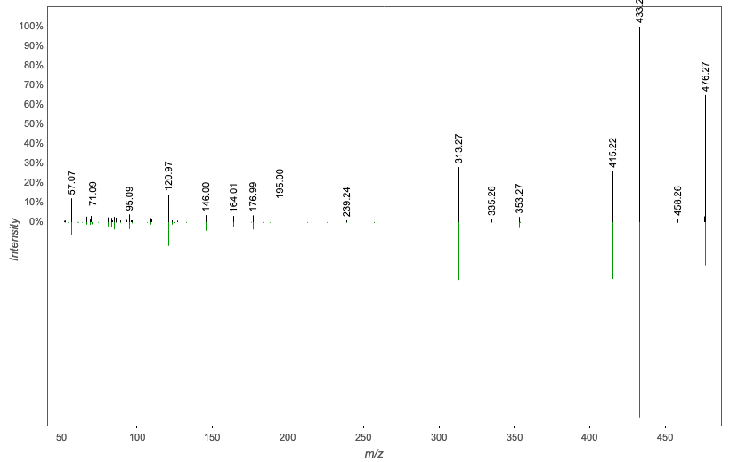
Annotation | M/Z | RT | Cosine Score | Shared Peaks | Cluster Index
Spectral Match to 1-Hexadecanoyl-sn-glycero-3-phosphoethanolamine from NIST14 | 476.273 | 2.9 | 0.9620 | 14 | 2818

Slide 12
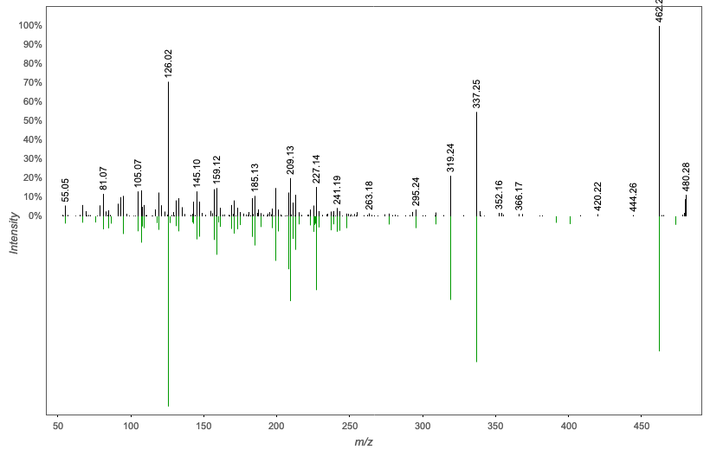
Annotation | M/Z | RT | Cosine Score | Shared Peaks | Cluster Index
taurocholic acid | 480.276 | 2.7 | 0.8381 | 16 | 2893

Slide 13
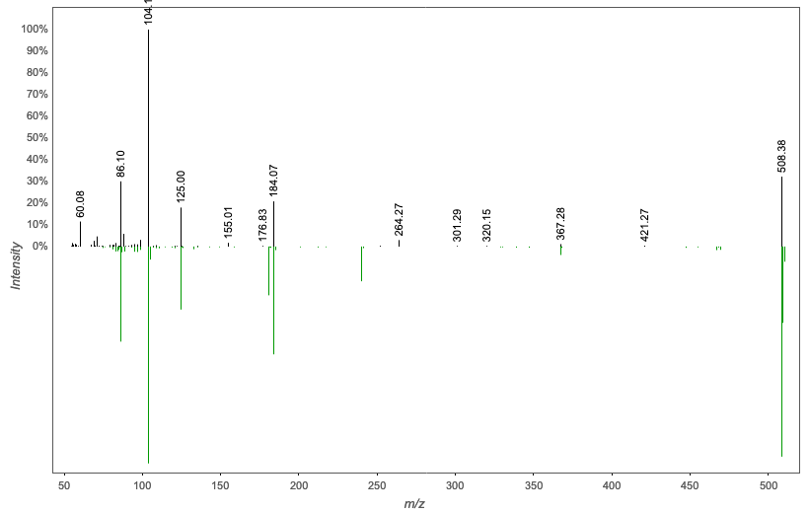
Annotation | M/Z | RT | Cosine Score | Shared Peaks | Cluster Index
Spectral Match to 1-(1Z-Octadecenyl)-sn-glycero-3-phosphocholine from NIST14 | 508.375 | 2.95 | 0.8138 | 6 | 1013

Slide 14
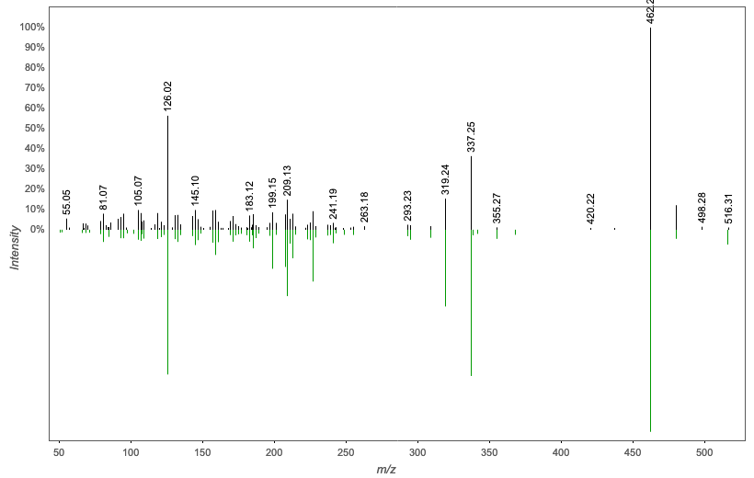
Annotation | M/Z | RT | Cosine Score | Shared Peaks | Cluster Index
taurocholic acid | 516.297 | 2.7 | 0.8860 | 19 | 2493

Slide 15
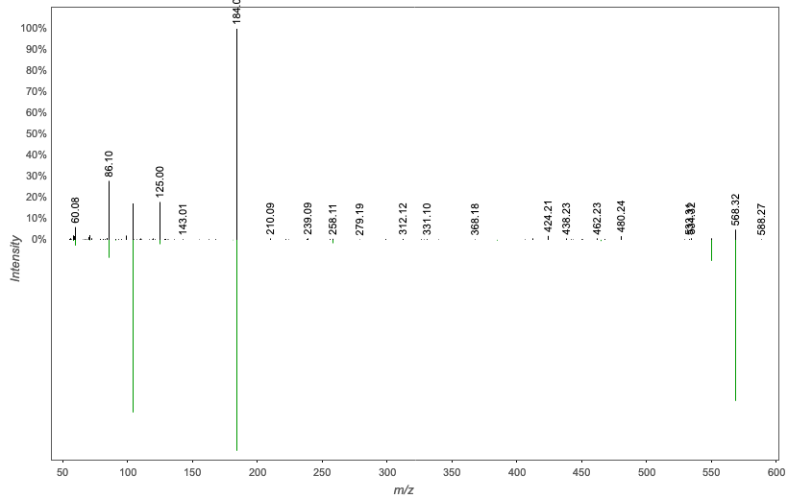
Annotation | M/Z | RT | Cosine Score | Shared Peaks | Cluster Index
Lyso PC (22:6) | 568.323 | 2.56 | 0.8441 | 8 | 1919

Slide 16
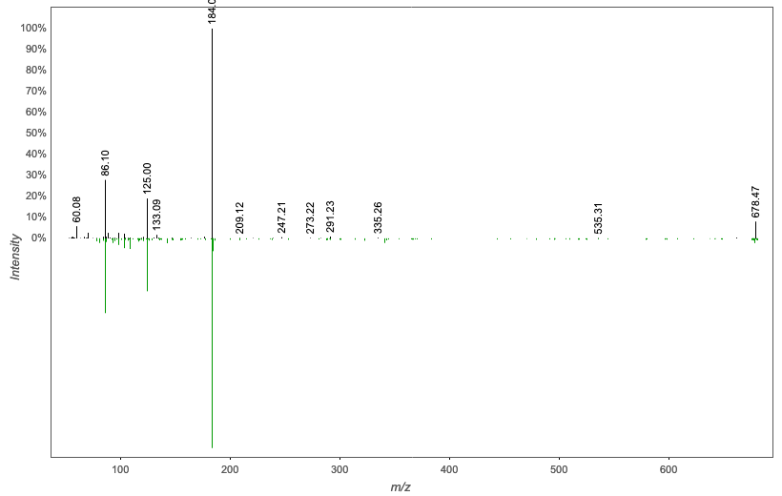
Annotation | M/Z | RT | Cosine Score | Shared Peaks | Cluster Index
Spectral Match to 1,2-Ditetradecanoyl-sn-glycero-3-phosphocholine from NIST14 | 678.468 | 3.18 | 0.8630 | 6 | 1580

Slide 17
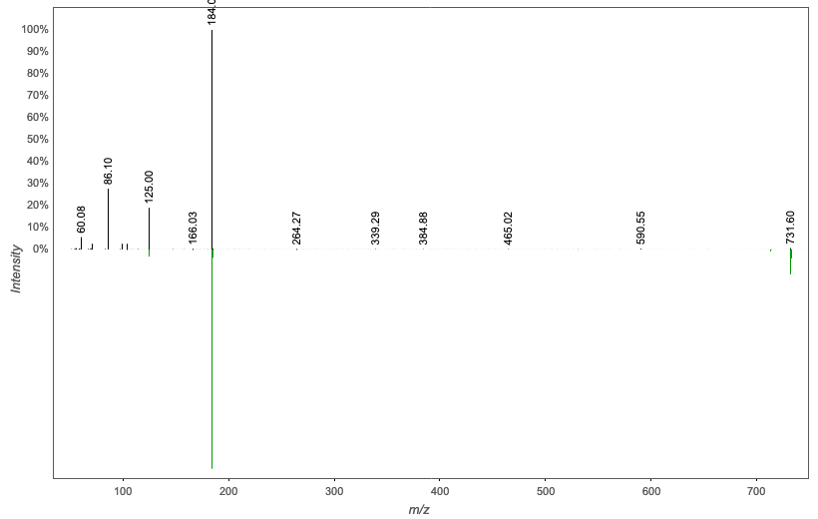
Annotation | M/Z | RT | Cosine Score | Shared Peaks | Cluster Index
3-hydroxy-2-stearamidooctadec-4-en-1-yl (2-(trimethylammonio)ethyl) phosphate | 731.604 | 5.57 | 0.8196 | 5 | 738

Slide 18
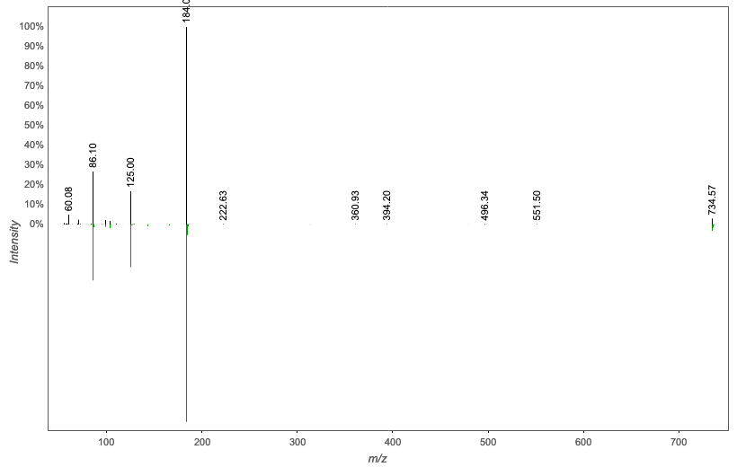
Annotation | M/Z | RT | Cosine Score | Shared Peaks | Cluster Index
Spectral Match to 1-Myristoyl-2-stearoyl-sn-glycero-3-phosphocholine from NIST14 | 734.567 | 5.57 | 0.9434 | 7 | 613

Slide 19
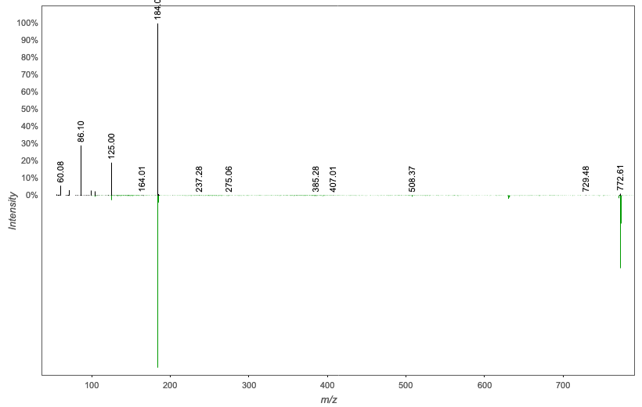
Annotation | M/Z | RT | Cosine Score | Shared Peaks | Cluster Index
trimethyl(2-{[2-[octadec-11-enoyloxy]-3-[octadec-9-en-1-yloxy]propyl phosphonato]oxy}ethyl)azanium | 772.617 | 3.44 | 0.7904 | 5 | 1252

Slide 20
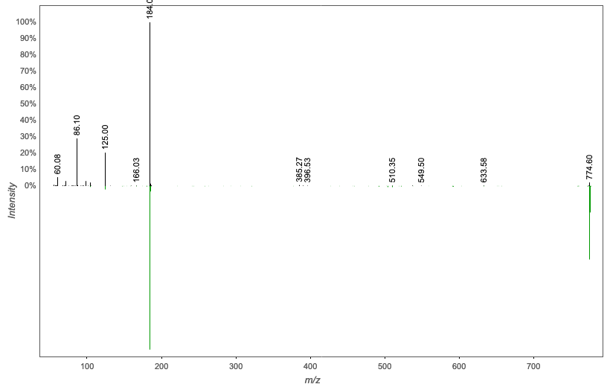
Annotation | M/Z | RT | Cosine Score | Shared Peaks | Cluster Index
3-(heptadecanoyloxy)-2-(oleoyloxy)propyl (2-(trimethylammonio)ethyl) phosphate | 774.597 | 5.61 | 0.8046 | 5 | 2464

Slide 21
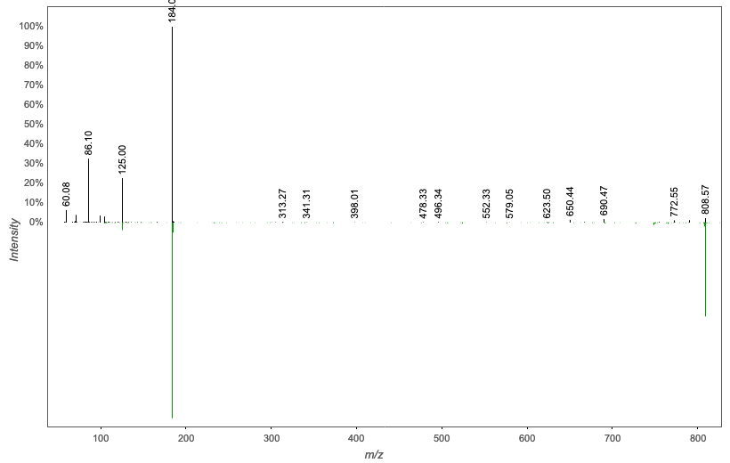
Annotation | M/Z | RT | Cosine Score | Shared Peaks | Cluster Index
(2-{[2-[docosa-4.7.10.13.16-pentaenoyloxy]-3-(hexadecanoyloxy)propyl phosphonato]oxy}ethyl)trimethylazanium | 808.568 | 3.06 | 0.7416 | 6 | 2650

Slide 22
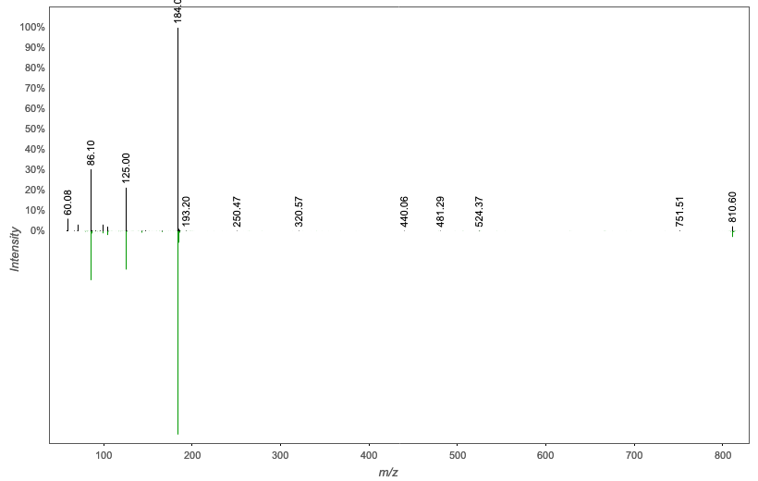
Annotation | M/Z | RT | Cosine Score | Shared Peaks | Cluster Index
Spectral Match to 1-Octadecanoyl-2-(5Z,8Z,11Z,14Z-eicosatetraenoyl)-sn-glycero-3-phosphocholine from NIST14 | 810.596 | 4.04 | 0.9515 | 8 | 3120

Slide 23
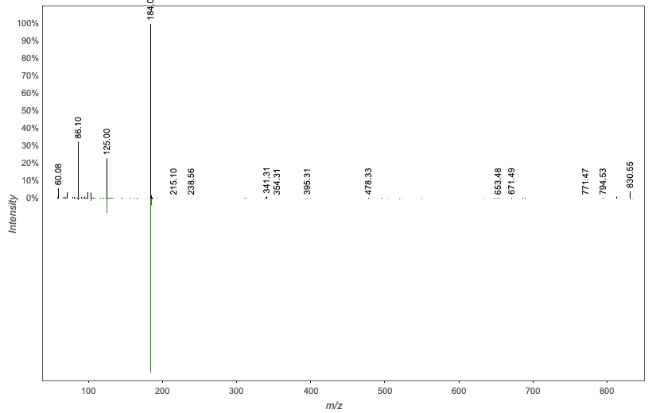
Annotation | M/Z | RT | Cosine Score | Shared Peaks | Cluster Index
Spectral Match to 1,2-Diarachidonoyl-sn-glycero-3-phosphocholine from NIST14 | 830.55 | 3.22 | 0.8611 | 10 | 1744

Slide 24

Annotation | M/Z | RT | Cosine Score | Shared Peaks | Cluster Index
Spectral Match to 1,2-Diarachidonoyl-sn-glycero-3-phosphocholine from NIST14 | 830.566 | 3.67 | 0.8593 | 9 | 1411

Slide 25
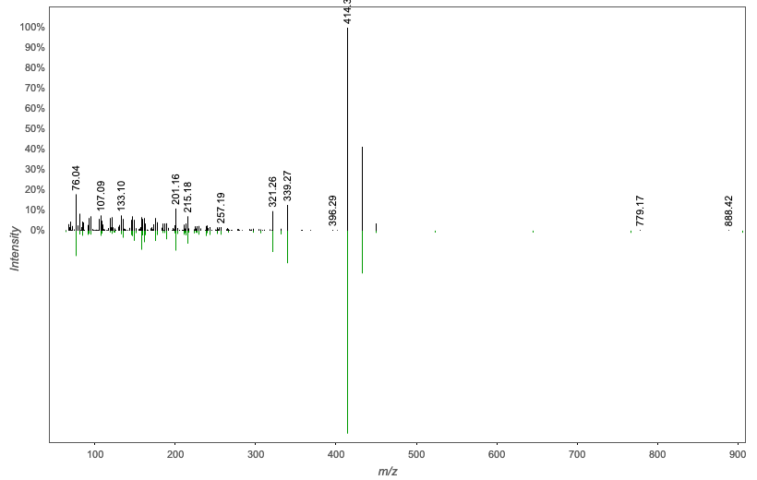
Annotation | M/Z | RT | Cosine Score | Shared Peaks | Cluster Index
glycochenodeoxycholic acid | 899.632 | 2.69 | 0.8559 | 17 | 2694

Slide 26
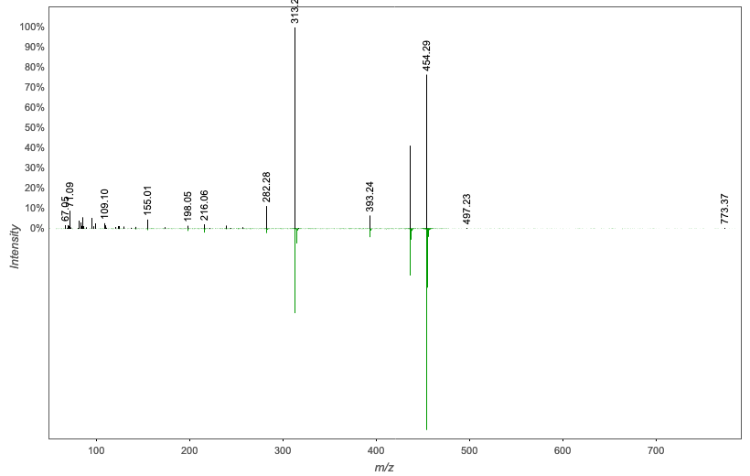
Annotation | M/Z | RT | Cosine Score | Shared Peaks | Cluster Index
Spectral Match to 1-Hexadecanoyl-sn-glycero-3-phosphoethanolamine from NIST14 | 907.575 | 2.89 | 0.7949 | 9 | 3917

Slide 27
Analogs
24 Annotations + 71 Analogs

Slide 28
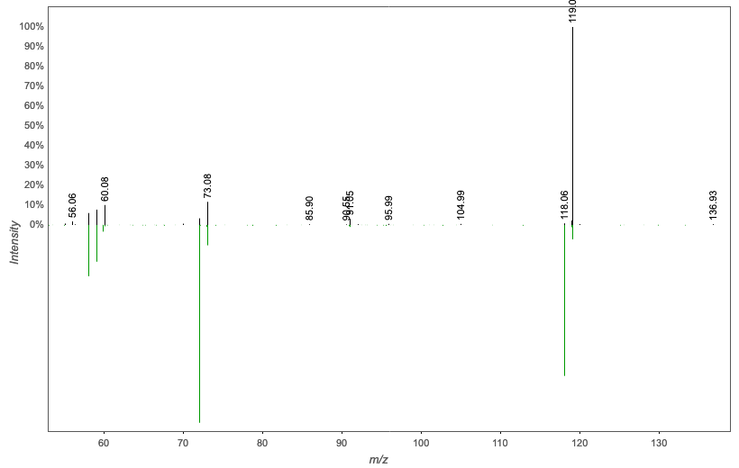
Annotation | M/Z | RT | Cosine Score | Shared Peaks | Cluster Index
L-NORVALINE - 70.0 eV | 119.089 | 0.31 | 0.7665 | 4 | 1108

Slide 29
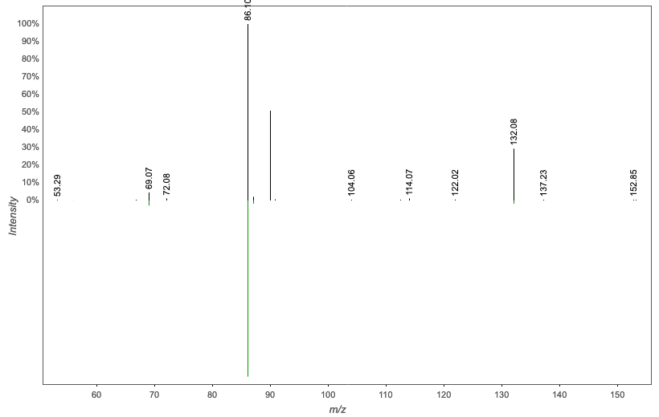
Annotation | M/Z | RT | Cosine Score | Shared Peaks | Cluster Index
Norleucine | 132.076 | 0.29 | 0.8295 | 4 | 940

Slide 30
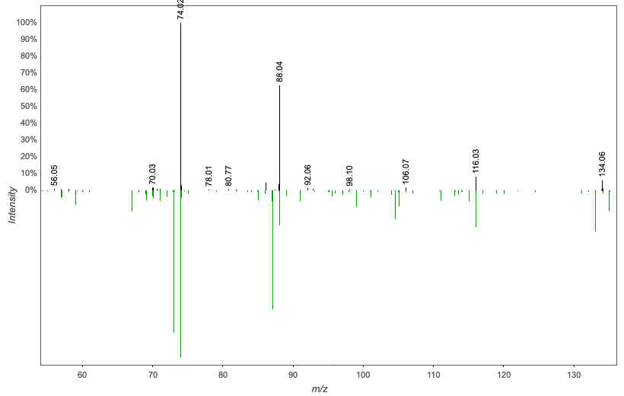
Annotation | M/Z | RT | Cosine Score | Shared Peaks | Cluster Index
asparagine | 134.044 | 0.33 | 0.8013 | 4 | 1016

Slide 31
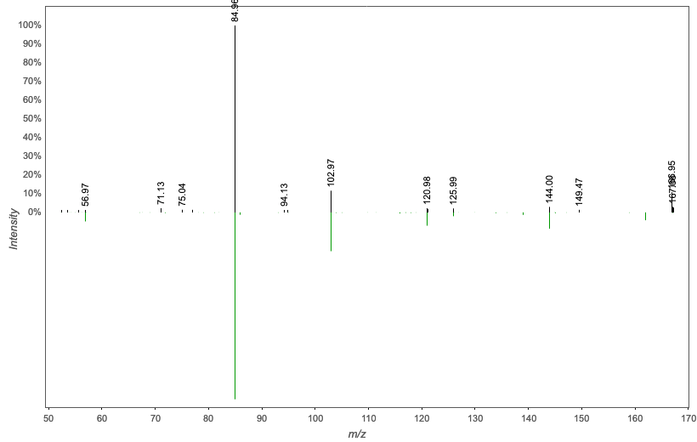
Annotation | M/Z | RT | Cosine Score | Shared Peaks | Cluster Index
23 | 166.95 | 0.28 | 0.9227 | 5 | 1266

Slide 32
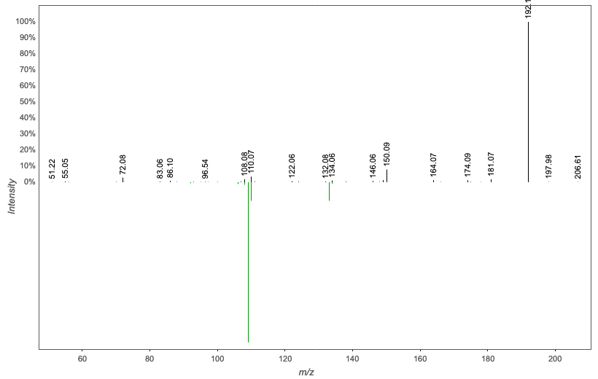
Annotation | M/Z | RT | Cosine Score | Shared Peaks | Cluster Index
Massbank:UF413504 4`-Aminoacetanilide|N-(4-Aminophenyl)acetamide | 192.102 | 2.2 | 0.7306 | 4 | 1317

Slide 33
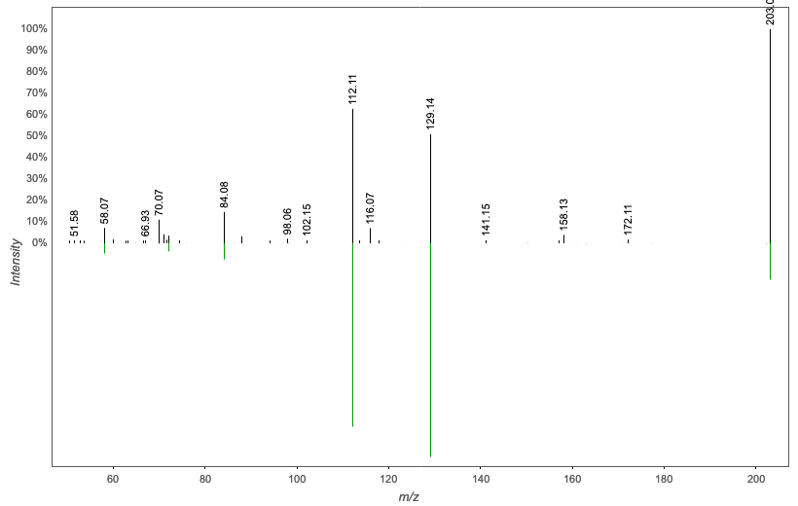
Annotation | M/Z | RT | Cosine Score | Shared Peaks | Cluster Index
SPERMINE | 203.052 | 0.26 | 0.8918 | 5 | 1264

Slide 34
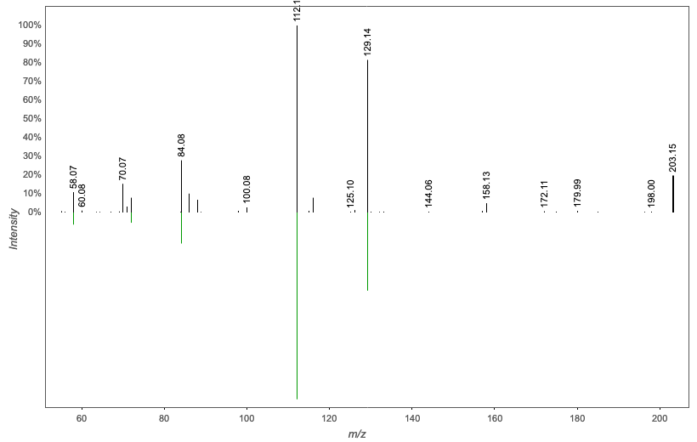
Annotation | M/Z | RT | Cosine Score | Shared Peaks | Cluster Index
Massbank:PB000488 Spermine|N,N'-bis(3-aminopropyl)butane-1,4-diamine | 203.15 | 0.25 | 0.9121 | 5 | 1043

Slide 35
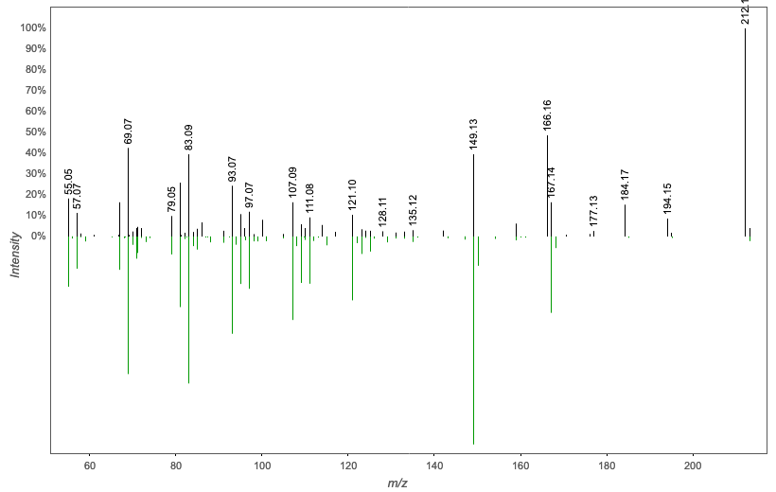
Annotation | M/Z | RT | Cosine Score | Shared Peaks | Cluster Index
Spectral Match to Dodecanedioic acid from NIST14 | 212.164 | 2.5 | 0.8823 | 8 | 1830

Slide 36
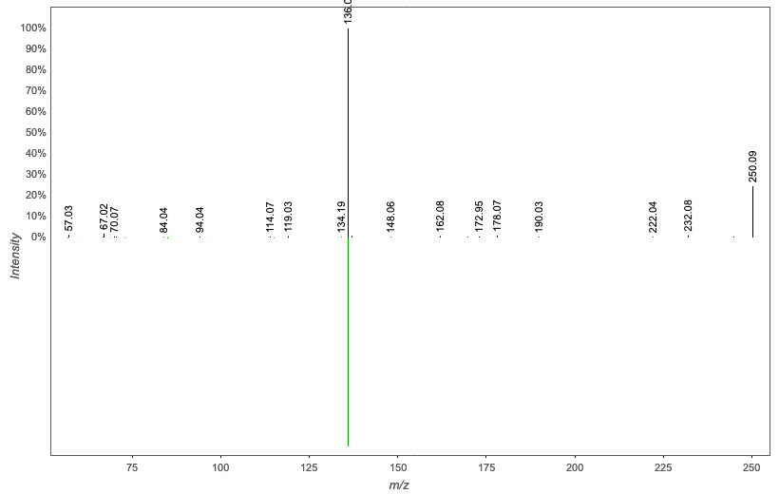
Annotation | M/Z | RT | Cosine Score | Shared Peaks | Cluster Index
Massbank:EQ330403 Adenosine|(2R,3R,4S,5R)-2-(6-aminopurin-9-yl)-5-(hydroxymethyl)oxolane-3,4-diol | 250.092 | 0.52 | 0.9774 | 5 | 2696

Slide 37
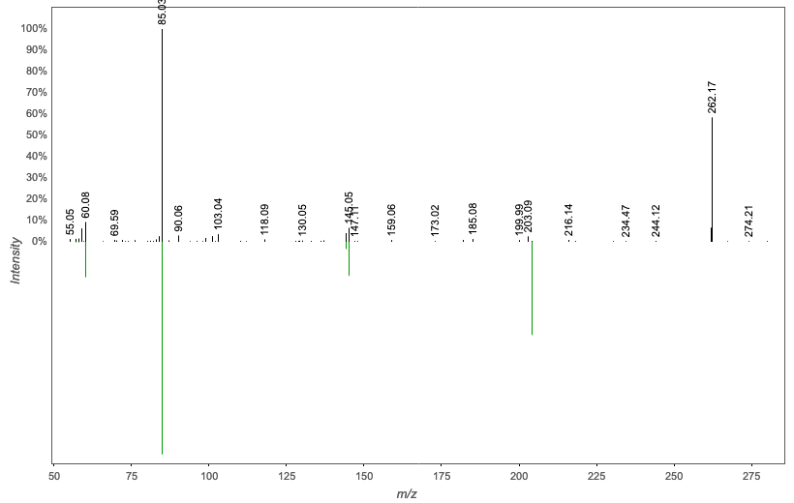
Annotation | M/Z | RT | Cosine Score | Shared Peaks | Cluster Index
O-ACETYLCARNITINE | 262.164 | 0.47 | 0.9113 | 5 | 2639

Slide 38
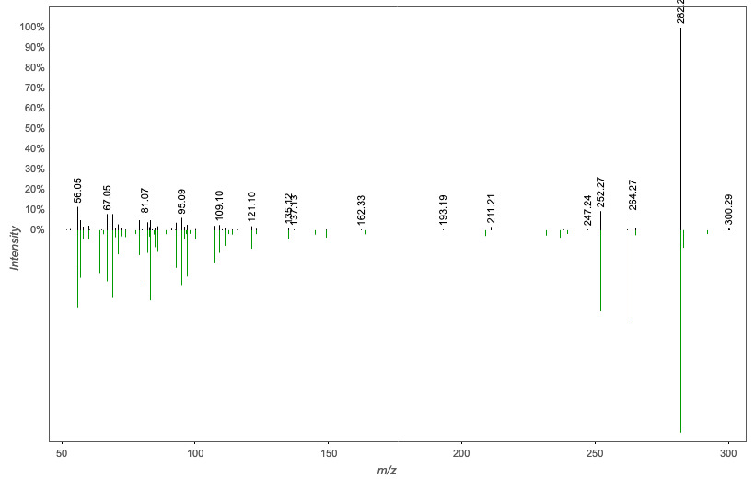
Annotation | M/Z | RT | Cosine Score | Shared Peaks | Cluster Index
Spectral Match to N-Tetracosenoyl-4-sphingenine from NIST14 | 300.288 | 2.79 | 0.7890 | 7 | 603

Slide 39
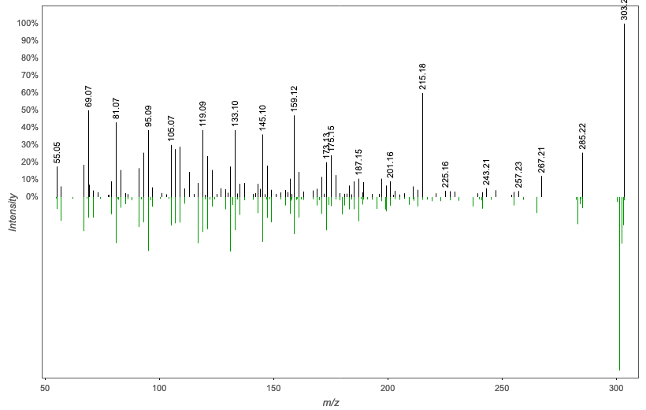
Annotation | M/Z | RT | Cosine Score | Shared Peaks | Cluster Index
Spectral Match to (+/-)-11-Hydroxy-5Z,8Z,12E,14Z,17Z-eicosapentaenoic acid from NIST14 | 303.23 | 3.07 | 0.7420 | 10 | 2718

Slide 40
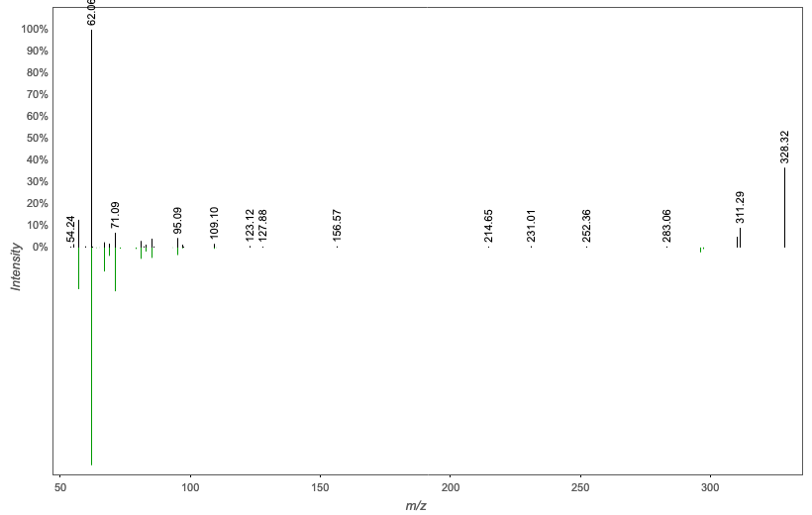
Annotation | M/Z | RT | Cosine Score | Shared Peaks | Cluster Index
Massbank:RP003203 Heptadecanoyl Ethanolamide|Margaroyl-ethanolamine|N-(2-hydroxyethyl)heptadecanamide | 328.319 | 3.22 | 0.9552 | 6 | 664

Slide 41
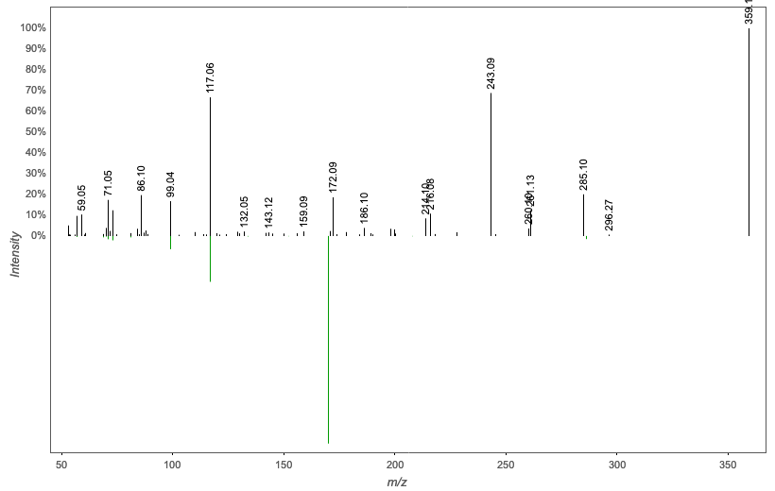
Annotation | M/Z | RT | Cosine Score | Shared Peaks | Cluster Index
Massbank:LU134302 Cladribine | 359.135 | 2.28 | 0.7149 | 6 | 2754

Slide 42
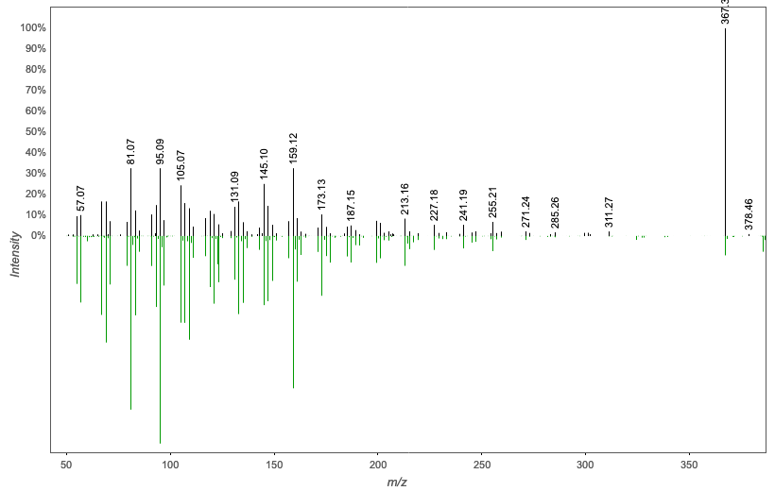
Annotation | M/Z | RT | Cosine Score | Shared Peaks | Cluster Index
3Beta-Hydroxy-23,24-Bisnorchol-5-Enic Acid | 367.334 | 3.35 | 0.8299 | 13 | 1674

Slide 43
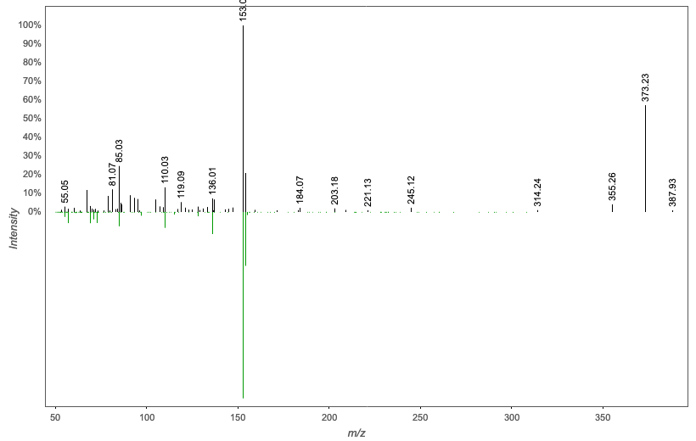
Annotation | M/Z | RT | Cosine Score | Shared Peaks | Cluster Index
XANTHOSINE - 50.0 eV | 373.222 | 2.78 | 0.7805 | 5 | 2034

Slide 44
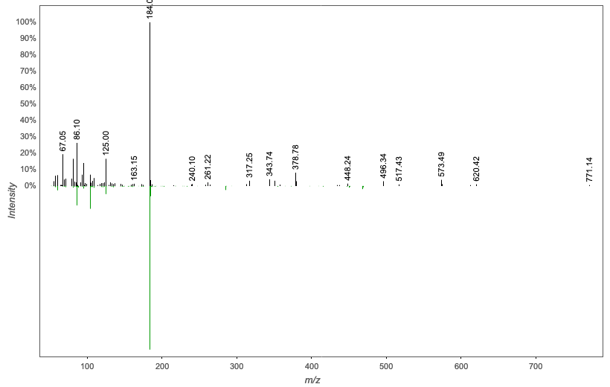
Annotation | M/Z | RT | Cosine Score | Shared Peaks | Cluster Index
Spectral Match to 1-Myristoyl-sn-glycero-3-phosphocholine from NIST14 | 378.779 | 3.42 | 0.7971 | 10 | 4953

Slide 45
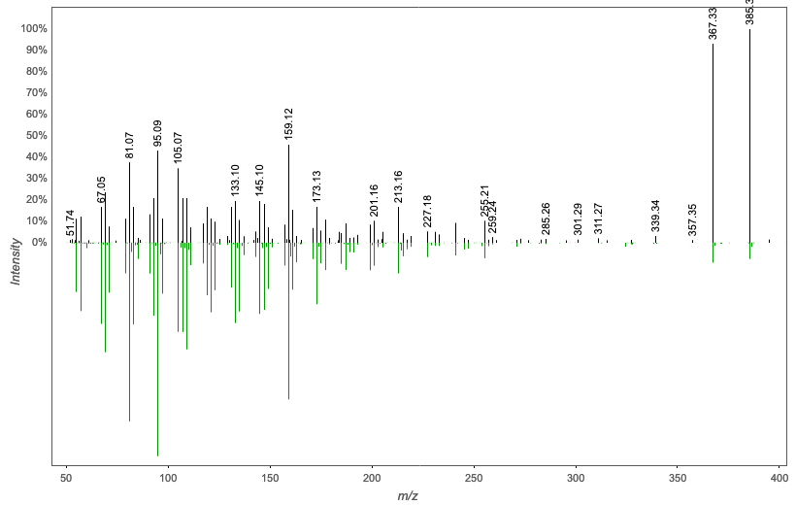
Annotation | M/Z | RT | Cosine Score | Shared Peaks | Cluster Index
3Beta-Hydroxy-23,24-Bisnorchol-5-Enic Acid | 385.345 | 3.35 | 0.8034 | 13 | 1848

Slide 46
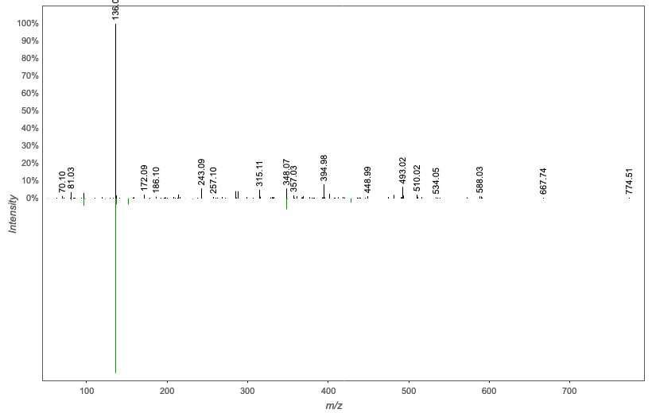
Annotation | M/Z | RT | Cosine Score | Shared Peaks | Cluster Index
Spectral Match to Adenosine 5'-diphosphate from NIST14 | 420.04 | 6.19 | 0.7847 | 6 | 2798

Slide 47
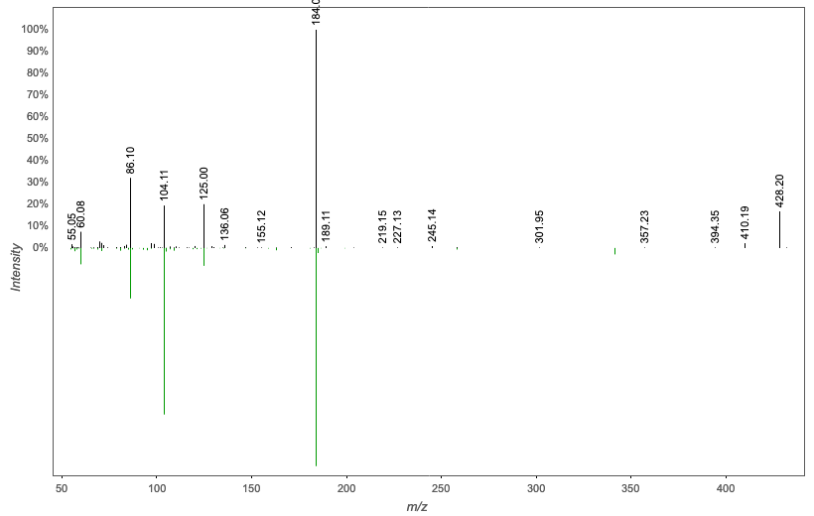
Annotation | M/Z | RT | Cosine Score | Shared Peaks | Cluster Index
Spectral Match to 1-Stearoyl-2-hydroxy-sn-glycero-3-phosphocholine from NIST14 | 428.205 | 2.24 | 0.9153 | 8 | 1481

Slide 48
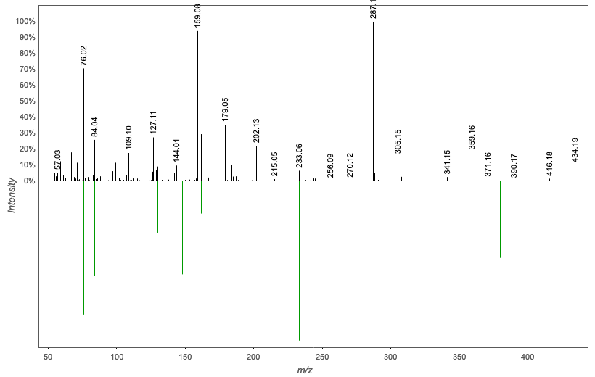
Annotation | M/Z | RT | Cosine Score | Shared Peaks | Cluster Index
Massbank:PR100314 S-Lactoylglutathione|S-Pyruvoylglutathione|S-Pyruvylglutathione | 434.195 | 2.36 | 0.7334 | 8 | 1767

Slide 49
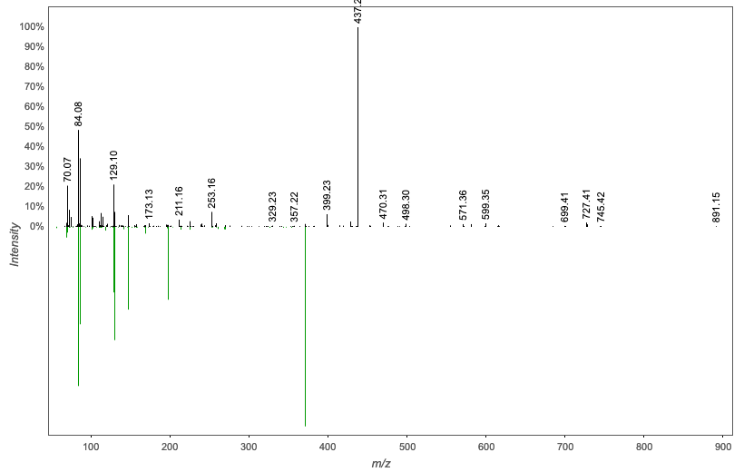
Annotation | M/Z | RT | Cosine Score | Shared Peaks | Cluster Index
Spectral Match to PyroGlu-Ile-Lys from NIST14 | 437.262 | 2.14 | 0.7587 | 11 | 4719

Slide 50
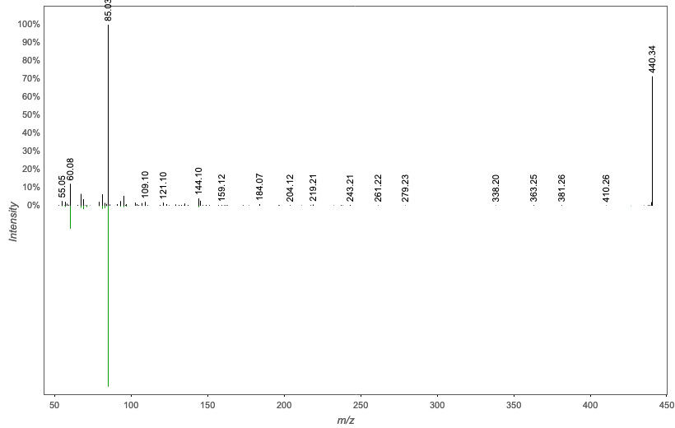
Annotation | M/Z | RT | Cosine Score | Shared Peaks | Cluster Index
Massbank:RP025103 Oleoyl-L-Carnitine|(3R)-3-[(Z)-octadec-9-enoyl]oxy-4-(trimethylazaniumyl)butanoate | 440.335 | 2.77 | 0.9353 | 6 | 1628

Slide 51
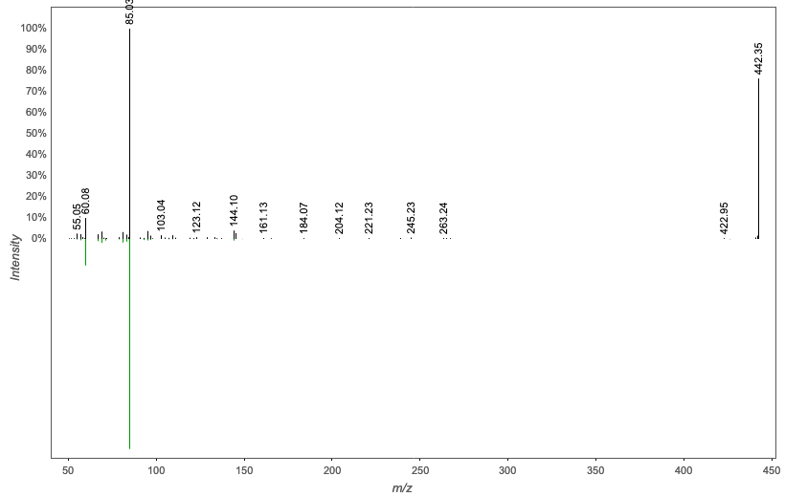
Annotation | M/Z | RT | Cosine Score | Shared Peaks | Cluster Index
Massbank:RP025103 Oleoyl-L-Carnitine|(3R)-3-[(Z)-octadec-9-enoyl]oxy-4-(trimethylazaniumyl)butanoate | 442.351 | 2.83 | 0.9352 | 5 | 1352

Slide 52

Annotation | M/Z | RT | Cosine Score | Shared Peaks | Cluster Index
Massbank:RP025103 Oleoyl-L-Carnitine|(3R)-3-[(Z)-octadec-9-enoyl]oxy-4-(trimethylazaniumyl)butanoate | 444.367 | 2.88 | 0.9425 | 5 | 4206

Slide 53
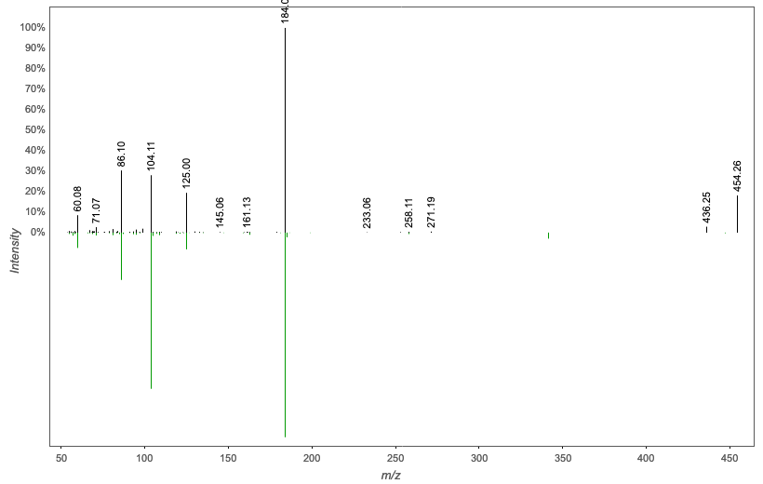
Annotation | M/Z | RT | Cosine Score | Shared Peaks | Cluster Index
Spectral Match to 1-Stearoyl-2-hydroxy-sn-glycero-3-phosphocholine from NIST14 | 454.256 | 2.37 | 0.9393 | 8 | 2724

Slide 54
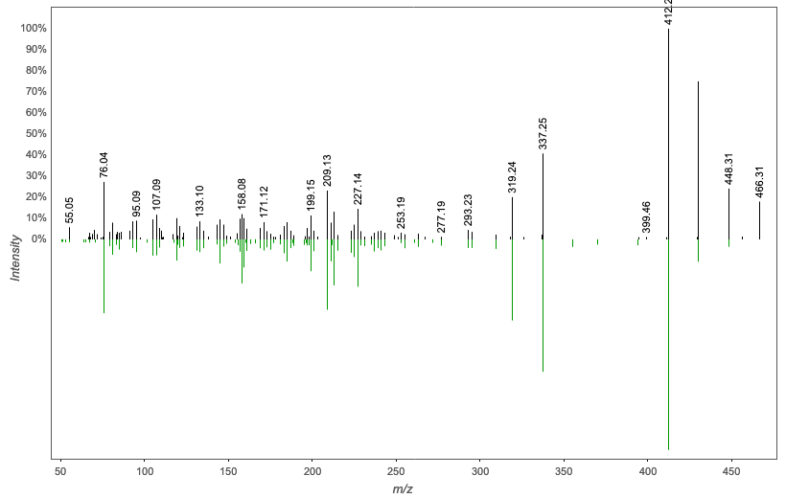
Annotation | M/Z | RT | Cosine Score | Shared Peaks | Cluster Index
GLYCOCHOLATE | 483.341 | 2.58 | 0.8517 | 18 | 4554

Slide 55
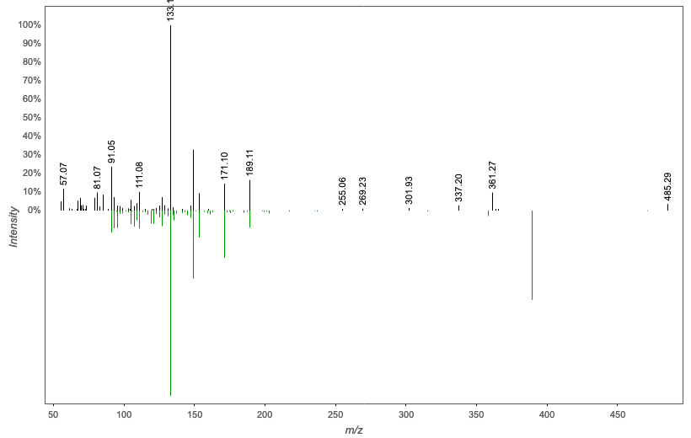
Annotation | M/Z | RT | Cosine Score | Shared Peaks | Cluster Index
PE(22:4/0:0); [M+H]+ C27H49N1O7P1 | 502.315 | 3.15 | 0.7649 | 7 | 1599

Slide 56

Annotation | M/Z | RT | Cosine Score | Shared Peaks | Cluster Index
PE(22:4/0:0); [M+H]+ C27H49N1O7P1 | 530.346 | 3.15 | 0.7859 | 8 | 1585

Slide 57

Annotation | M/Z | RT | Cosine Score | Shared Peaks | Cluster Index
Spectral Match to 1-Palmitoyl-2-hydroxy-sn-glycero-3-phosphoethanolamine from NIST14 | 538.312 | 2.95 | 0.7623 | 12 | 2669

Slide 58

Annotation | M/Z | RT | Cosine Score | Shared Peaks | Cluster Index
Spectral Match to 1-(9Z-Octadecenoyl)-2-tetradecanoyl-sn-glycero-3-phosphocholine from NIST14 | 636.421 | 3.21 | 0.7675 | 5 | 2374

Slide 59

Annotation | M/Z | RT | Cosine Score | Shared Peaks | Cluster Index
Cer(d18:1/24:1); [M+H]+ C42H82N1O3 | 636.627 | 5.17 | 0.8194 | 8 | 2561

Slide 60

Annotation | M/Z | RT | Cosine Score | Shared Peaks | Cluster Index
DIDECANOYL-GLYCEROPHOSPHOCHOLINE | 638.436 | 2.98 | 0.9497 | 6 | 1195

Slide 61

Annotation | M/Z | RT | Cosine Score | Shared Peaks | Cluster Index
Cer(d18:1/24:1); [M+H]+ C42H82N1O3 | 650.642 | 5.42 | 0.8282 | 8 | 2543

Slide 62

Annotation | M/Z | RT | Cosine Score | Shared Peaks | Cluster Index
Spectral Match to 1-(9Z-Octadecenoyl)-2-tetradecanoyl-sn-glycero-3-phosphocholine from NIST14 | 666.467 | 3.09 | 0.9553 | 8 | 2703

Slide 63

Annotation | M/Z | RT | Cosine Score | Shared Peaks | Cluster Index
Spectral Match to 1-(9Z-Octadecenoyl)-2-tetradecanoyl-sn-glycero-3-phosphocholine from NIST14 | 692.483 | 3.24 | 0.9469 | 8 | 2531

Slide 64

Annotation | M/Z | RT | Cosine Score | Shared Peaks | Cluster Index
Cer(d18:1/22:1); [M+H]+ C40H78N1O3 | 698.605 | 3.49 | 0.7261 | 6 | 2735

Slide 65

Annotation | M/Z | RT | Cosine Score | Shared Peaks | Cluster Index
Spectral Match to 1-Hexadecanoyl-2-(9Z-octadecenoyl)-sn-glycero-3-phosphocholine from NIST14 | 702.429 | 3.13 | 0.8346 | 9 | 2011

Slide 66

Annotation | M/Z | RT | Cosine Score | Shared Peaks | Cluster Index
Spectral Match to 1,2-Dipalmitoleoyl-sn-glycero-3-phosphocholine from NIST14 | 703.537 | 3.14 | 0.9633 | 7 | 1259

Slide 67

Annotation | M/Z | RT | Cosine Score | Shared Peaks | Cluster Index
Spectral Match to 1-Myristoyl-2-palmitoyl-sn-glycero-3-phosphocholine from NIST14 | 706.462 | 3.09 | 0.9467 | 7 | 1152

Slide 68

Annotation | M/Z | RT | Cosine Score | Shared Peaks | Cluster Index
Spectral Match to 1-(9Z-Octadecenoyl)-2-tetradecanoyl-sn-glycero-3-phosphocholine from NIST14 | 708.441 | 2.97 | 0.9004 | 9 | 3401

Slide 69

Annotation | M/Z | RT | Cosine Score | Shared Peaks | Cluster Index
Cer(d18:1/24:0(2OH)); [M+H]+ C42H84N1O4 | 714.491 | 2.81 | 0.7322 | 8 | 1681

Slide 70

Annotation | M/Z | RT | Cosine Score | Shared Peaks | Cluster Index
Spectral Match to N-Stearoyl-4-sphingenyl-1-O-phosphorylcholine from NIST14 | 725.555 | 5.57 | 0.8349 | 8 | 1650

Slide 71

Annotation | M/Z | RT | Cosine Score | Shared Peaks | Cluster Index
PE-DAG (16:1/18:2) | 742.535 | 5.56 | 0.8098 | 16 | 2500

Slide 72

Annotation | M/Z | RT | Cosine Score | Shared Peaks | Cluster Index
PE(16:0/22:6); [M+H]+ C43H75N1O8P1 | 764.518 | 3.64 | 0.7629 | 12 | 602

Slide 73

Annotation | M/Z | RT | Cosine Score | Shared Peaks | Cluster Index
PE(18:1/20:4); [M+H]+ C43H77N1O8P1 | 766.534 | 5.56 | 0.7334 | 16 | 679

Slide 74

Annotation | M/Z | RT | Cosine Score | Shared Peaks | Cluster Index
Spectral Match to 1-Myristoyl-2-stearoyl-sn-glycero-3-phosphocholine from NIST14 | 772.545 | 3.45 | 0.9385 | 9 | 1377

Slide 75

Annotation | M/Z | RT | Cosine Score | Shared Peaks | Cluster Index
Spectral Match to 1-Myristoyl-2-palmitoyl-sn-glycero-3-phosphocholine from NIST14 | 774.56 | 3.42 | 0.9474 | 7 | 1455

Slide 76

Annotation | M/Z | RT | Cosine Score | Shared Peaks | Cluster Index
Spectral Match to 1-Hexadecyl-2-(9Z-octadecenoyl)-sn-glycero-3-phosphocholine from NIST14 | 788.515 | 3.81 | 0.8642 | 10 | 2509

Slide 77

Annotation | M/Z | RT | Cosine Score | Shared Peaks | Cluster Index
Spectral Match to 1-Myristoyl-2-stearoyl-sn-glycero-3-phosphocholine from NIST14 | 788.541 | 3.31 | 0.9434 | 8 | 322

Slide 78

Annotation | M/Z | RT | Cosine Score | Shared Peaks | Cluster Index
Spectral Match to 1-(9Z-Octadecenoyl)-2-tetradecanoyl-sn-glycero-3-phosphocholine from NIST14 | 790.556 | 3.28 | 0.9499 | 10 | 415

Slide 79

Annotation | M/Z | RT | Cosine Score | Shared Peaks | Cluster Index
PE(18:0/22:6); [M+H]+ C45H79N1O8P1 | 792.55 | 5.55 | 0.7282 | 16 | 748

Slide 80

Annotation | M/Z | RT | Cosine Score | Shared Peaks | Cluster Index
Spectral Match to 1-Hexadecanoyl-2-(9Z-octadecenoyl)-sn-glycero-3-phosphocholine from NIST14 | 795.569 | 5.56 | 0.7561 | 7 | 2056

Slide 81

Annotation | M/Z | RT | Cosine Score | Shared Peaks | Cluster Index
Spectral Match to 1-Hexadecanoyl-2-(9Z-octadecenoyl)-sn-glycero-3-phosphocholine from NIST14 | 796.508 | 3.25 | 0.9027 | 12 | 2884

Slide 82

Annotation | M/Z | RT | Cosine Score | Shared Peaks | Cluster Index
Spectral Match to 1-Hexadecanoyl-2-(9Z-octadecenoyl)-sn-glycero-3-phosphocholine from NIST14 | 796.544 | 3.43 | 0.9179 | 10 | 1668

Slide 83

Annotation | M/Z | RT | Cosine Score | Shared Peaks | Cluster Index
Spectral Match to 1-Octadecanoyl-2-(5Z,8Z,11Z,14Z-eicosatetraenoyl)-sn-glycero-3-phosphocholine from NIST14 | 800.576 | 3.65 | 0.9373 | 8 | 1911

Slide 84

Annotation | M/Z | RT | Cosine Score | Shared Peaks | Cluster Index
Spectral Match to 1-(9Z-Octadecenoyl)-2-tetradecanoyl-sn-glycero-3-phosphocholine from NIST14 | 800.613 | 5.62 | 0.9452 | 7 | 2640

Slide 85

Annotation | M/Z | RT | Cosine Score | Shared Peaks | Cluster Index
Spectral Match to 1-Hexadecanoyl-2-(9Z-octadecenoyl)-sn-glycero-3-phosphocholine from NIST14 | 804.549 | 3.64 | 0.9172 | 10 | 2466

Slide 86

Annotation | M/Z | RT | Cosine Score | Shared Peaks | Cluster Index
Spectral Match to 1-Octadecanoyl-2-octadecenoyl-sn-glycero-3-phosphocholine from NIST14 | 810.522 | 3.31 | 0.8096 | 8 | 1623

Slide 87

Annotation | M/Z | RT | Cosine Score | Shared Peaks | Cluster Index
Spectral Match to 1-Oleoyl-2-palmitoyl-sn-glycero-3-phosphocholine from NIST14 | 814.555 | 3.23 | 0.9520 | 9 | 4231

Slide 88

Annotation | M/Z | RT | Cosine Score | Shared Peaks | Cluster Index
Spectral Match to 1-Myristoyl-2-stearoyl-sn-glycero-3-phosphocholine from NIST14 | 814.555 | 3.33 | 0.9495 | 9 | 1494

Slide 89

Annotation | M/Z | RT | Cosine Score | Shared Peaks | Cluster Index
Spectral Match to 1-Oleoyl-2-palmitoyl-sn-glycero-3-phosphocholine from NIST14 | 816.57 | 3.3 | 0.9468 | 8 | 2519

Slide 90

Annotation | M/Z | RT | Cosine Score | Shared Peaks | Cluster Index
Spectral Match to 1-Myristoyl-2-stearoyl-sn-glycero-3-phosphocholine from NIST14 | 818.586 | 3.41 | 0.9520 | 8 | 1461

Slide 91

Annotation | M/Z | RT | Cosine Score | Shared Peaks | Cluster Index
Spectral Match to 1-Myristoyl-2-stearoyl-sn-glycero-3-phosphocholine from NIST14 | 820.581 | 3.97 | 0.9394 | 7 | 2690

Slide 92

Annotation | M/Z | RT | Cosine Score | Shared Peaks | Cluster Index
Spectral Match to 1-Myristoyl-2-stearoyl-sn-glycero-3-phosphocholine from NIST14 | 828.535 | 3.22 | 0.9326 | 11 | 1645

Slide 93

Annotation | M/Z | RT | Cosine Score | Shared Peaks | Cluster Index
Spectral Match to 1-Hexadecanoyl-2-(9Z-octadecenoyl)-sn-glycero-3-phosphocholine from NIST14 | 834.597 | 4.17 | 0.9351 | 8 | 1328

Slide 94

Annotation | M/Z | RT | Cosine Score | Shared Peaks | Cluster Index
Spectral Match to N-Oleoyl-D-erythro-sphingosylphosphorylcholine from NIST14 | 835.663 | 5.57 | 0.8505 | 8 | 1060

Slide 95

Annotation | M/Z | RT | Cosine Score | Shared Peaks | Cluster Index
Spectral Match to N-Oleoyl-D-erythro-sphingosylphosphorylcholine from NIST14 | 850.515 | 3.22 | 0.8427 | 6 | 1831

Slide 96

Annotation | M/Z | RT | Cosine Score | Shared Peaks | Cluster Index
Spectral Match to 1-Octadecanoyl-2-octadecenoyl-sn-glycero-3-phosphocholine from NIST14 | 852.532 | 3.22 | 0.8144 | 8 | 1867

Slide 97

Annotation | M/Z | RT | Cosine Score | Shared Peaks | Cluster Index
Spectral Match to 1-Oleoyl-2-palmitoyl-sn-glycero-3-phosphocholine from NIST14 | 858.58 | 3.32 | 0.9444 | 7 | 1986

Slide 98

Annotation | M/Z | RT | Cosine Score | Shared Peaks | Cluster Index
Spectral Match to 1-Octadecanoyl-2-(5Z,8Z,11Z,14Z-eicosatetraenoyl)-sn-glycero-3-phosphocholine from NIST14 | 870.545 | 3.24 | 0.9528 | 9 | 3358

